Slide 1

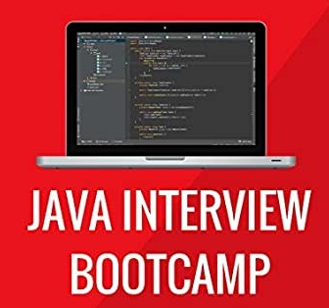
JAVA Java Interview boot camp Core concepts
Lecture 20
CHAPTER 20
Modern Java

Slide 2
Modern Java
(Java’s New Ecosystem !)

Slide 3
Today’s Agenda
An Introduction to Modern Java
What Is Modern Java ?
What Is LTS and STS ?
Why Java 8 Is So Popular ?
New Features Of Java 8

Slide 4
What Is Modern Java ?
Over twenty four years after its inception, Java still continues to be one of the most utilized programming languages in the world.
But to support technology advancements that are happening around the world , the creators of Java language decided to support Declarative Programming features to Java.

Slide 5
What Is Declarative Programming ?
Declarative programming is where we say what we want without having to say how to do it.
In declarative programming, the source code is written in a way that it expresses the desired outcome with little or no emphasis on the actual implementation.

Slide 6
What Do We Call Our Approach Till Now ?
The approach we have taken till now in Java is called Imperative Programming
In this approach , we tell the computer how to achieve the goal i.e. we tell each step of the algorithm
Imperative programming is writing lines of code that represent the instructions of how to achieve the desired outcome.

Slide 7
Imperative V/s Declarative
Suppose , you went to a restaurant with 5 friends of yours.
How will you get the seat in the restaurant ?
Imperative Approach:
“I see that table located under the AC is empty. We all are going to walk over there and sit down.”
Declarative Approach:
“Table for six, please.”

Slide 8
Another Example
Suppose , your friend is coming to your home for the first time.
So he says : “I’m right next to Reliance Fresh. How do I get to your house from here?”
Imperative Response:
“Go out of the north side of the parking lot and take a left. Get to the 2nd lane. Take a right off and go straight and take a right at the first lamp post. Continue through the 2nd lamp post , then take your next left. My house is #305.”
Declarative Approach:
“My address is 305, E-4/799, Arera- 462019.”

Slide 9
Well Known Examples Of Declarative Programming
SQL and HTML/CSS are two well-known examples of declarative programming.
Take a look at the following SQL statement:
SELECT * FROM employee WHERE empno=101;
Here we are just instructing the DBMS to get the record of the employee 101,without instructing, how to achieve it.
The implementation of SELECTING RECORD for emp id 101 is abstract from us

Slide 10
Well Known Examples Of Declarative Programming
Take a look at the following HTML CODE:
<body>
<h1>Learning Java 8</h1>
<p>
A great way to become <b>SMART PROGRAMMER</b>
</p>
</body>
We’re not concerned with how the web browser is parsing our <h1> or <p> or <b> element and displaying it to the screen.
Our WHAT is a new header and paragraph on our website.

Slide 11
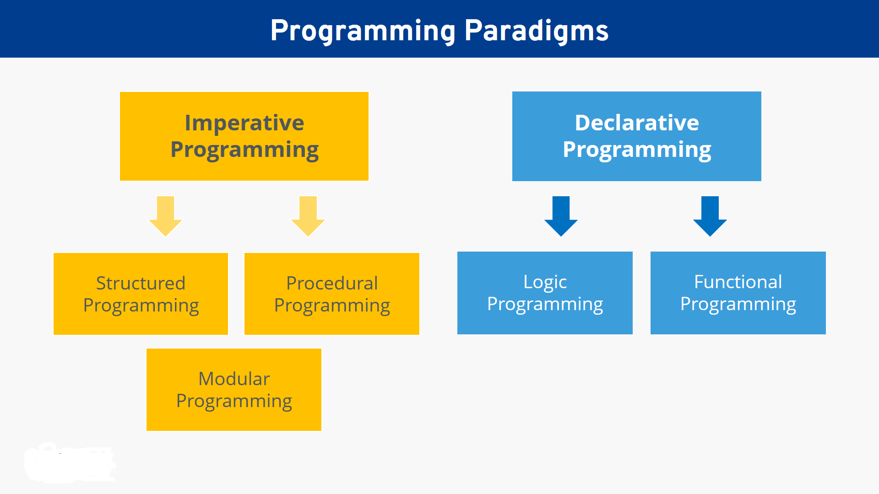
Imperative V/s Declarative

Slide 12
How Java Was Enhanced To Support Declarative Programming ?
Creators of Java language thought that a Java programmer must also be able to think and code in Declarative Style of programming

Slide 13
How Java Was Enhanced To Support Declarative Programming ?
From Java 8 which is also called as Modern Java , we can now write our codes in Declarative Style using Functional Programming with Lambda Expressions
So that our code becomes concise as well as much more simplified.

Slide 14
Example 1
To understand this , let’s see an example to print nos from 1 to 5 in old style as well as new style.
Old Style
New Style:
for(int i=1;i<=5;i++)
System.out.println(i);
IntStream nums=IntStream.of(1,2,3,4,5);
nums.forEach(i->System.out.println(i));

Slide 15
Example 2
Let’s see another example to calculate sum of nos from 1 t0 100 in old style as well as new style.
Old Style
New Style:
int sum=0;
for(int i=1;i<=100;i++)
sum=sum+i;
System.out.println(“sum is ”+sum);
int sum=IntStream.rangeClosed(1,100).sum();
System.out.println(“sum is ”+sum);

Slide 16
Example 3
Take another example to define a method that takes an ArrayList of Integers as argument and returns a List with all duplicates removed.

Slide 17
Example 3
Old Style
New Style:
public static List<Integer> getUniqueList(ArrayList<Integer> numbers)
{
List<Integer>uniqueList=new ArrayList<>();
for(Integer n:numbers)
{
if(uniqueList.contains(n)==false)
uniqueList.add(n);
}
return uniqueList;
}
public static List<Integer> getUniqueList(ArrayList<Integer> numbers)
{
List<Integer>uniqueList=numbers.stream().distinct().collect(Collectors.toList());
return uniqueList;
}

Slide 18
What Else Is There In Modern Java ?
Nowadays , even a smart phone has multiple processors.
To use the power of these multiple processors , prior to modernization of Java , we had to use very high level of multithreaded code.
But we know that working with threads is not so easy and we have to be very careful while writing multithreaded code.

Slide 19
What Is Modern Java ?
With Modern Java , we can now write codes performing parallel operations using multiple processors

Slide 20
Benefits
So we can say that the main benefits of the addition of these new features to Java are:
Programmer needs to write less code
Simplifies programming
Takes advantage of hardware enhancements

Slide 21
When Were These Features Added ?
All the new features which we have and will discuss in this course were added in Java 8 which came out in March 2104.
Before Java 8 , the major release of Java was Java 5 in which many new features like Enhanced for loop, Scanner , static import , Autoboxing and Unboxing , Va-args etc were added.
Then Java 6 and Java 7 were minor releases and not many new features were added.

Slide 22
When Were These Features Added ?
Then with the launch of Java 8 changes to Java were in many ways more profound than any other changes to Java in it’s history.
Similarly , Java 9 and Java 10 were again minor releases but Java 11 came with more popular features mainly focused on String handling, single line, single-file build and enhancements to features of Java 8.

Slide 23
LTS And STS
The last 5 years have seen some rapid changes in the way new versions of the Java Development Kit is deployed and maintained.
Traditionally, new Java versions were always released in a 2 to 4 year life cycle.
Every 2 to 4 years, a new JDK would be released, containing some new features .

Slide 24
LTS And STS
JDK Release Tmeline
– JDK 6: 2 years and 3 months after JDK 5 ( Dec,2006)
– JDK 7: 4 years and 7 months after JDK 6 (July , 2011)
– JDK 8: 2 years and 8 months after JDK 7 ( Mar,2014)
– JDK 9: 3 years and 6 months after JDK 8 (Sep, 2017)

Slide 25
LTS And STS
But from Java 10 , Oracle changed the new release policy and decided to launch a new version of Java every 6 months.
JDK Release Tmeline From Java 10
– JDK 10: 6 months after JDK 9 ( Mar ,2018)
– JDK 11: 6 months after JDK 10 ( Sep ,2018)
– JDK 12: 6 months after JDK 11 ( Mar ,2019)
– JDK 13: 6 months after JDK 12 (Sep, 2019)
– JDK 14: 6 months after JDK 13 ( Mar ,2020)
– JDK 15: 6 months after JDK 14 (Sep, 2020)
– JDK 16: 6 months after JDK 15 (Mar, 2021)
– JDK 17: 6 months after JDK 16 (Sep, 2021)

Slide 26
LTS And STS
Now , it became very difficult for Software Developers to keep their applications or several hundred (thousand?) servers up to date with the newest Java release.
That is why , the concept of an LTS was established.

Slide 27
LTS And STS
A Java LTS (long-term support) release is a version of Java that will remain the industry standard for several years.
To give an example of this, Java 8 was released in 2014, it will continue to receive updates until 2020, and extended support will end by 2030.
This gives plenty of time to application developers to update their applications to take full advantage of Java 8 features.

Slide 28
LTS And STS
The next LTS version is Java 11, which was released in 2018 and will continue to receive updates until 2026, with a strong possibility of date extension
The next 4 releases of Java, after Java 11, which are Java 12 , Java 13 , Java 14 & Java 15 are all STS ( Short Term Support)
JDK 17, which has released in September 2021, is the latest LTS release and will be supported as long as Sep 2029 with a strong possibility of date extension

Slide 29
List Of New Features
Following are the most important and used features of Java 8 :
Default And Static Methods In Interface
Lambda Expressions
Functional Interfaces
Stream API

